Slide 1
PYTHON
UpSkill Program
Instructor : Sujan Sharma
Vedas College
ML Engineer, Fusemachines Inc.
Visiting Faculty Lecturer, Vedas College

Slide 2
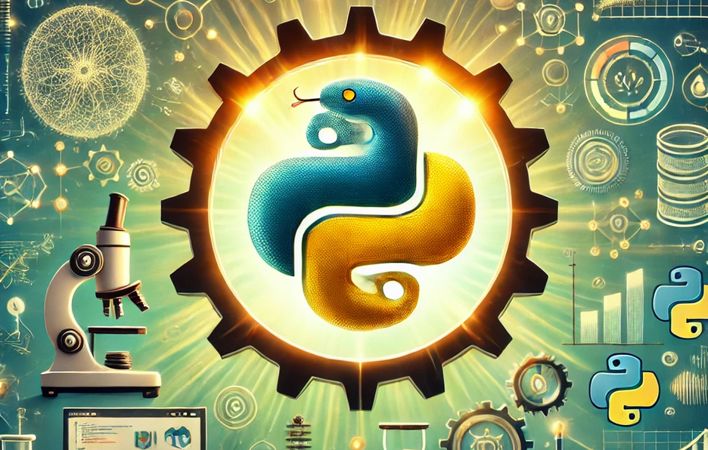
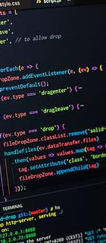
Imagine a tool that's powerful enough to drive Artificial Intelligence, easy enough to Create Websites, flexible enough to Analyze Data, and handy for Scientific Research, all while being Beginner-Friendly!
That’s Python…

Slide 3
Training Overview
quizzes
3+
Portfolio Projects
10+
Basic Projects
Total Duration
25 Hours
Theory + Coding ( Practical )

Slide 4
Training - Outline
Introduction to Python Programming
Control Structures and Functions
Data Structures
Object-oriented Programming (OOP)
Error Handling and Debugging
File Handling
Introduction to Modules and Libraries
Data Science and Visualization Basics
Introduction to Machine Learning
Advanced Python Concepts and Practices

Slide 5
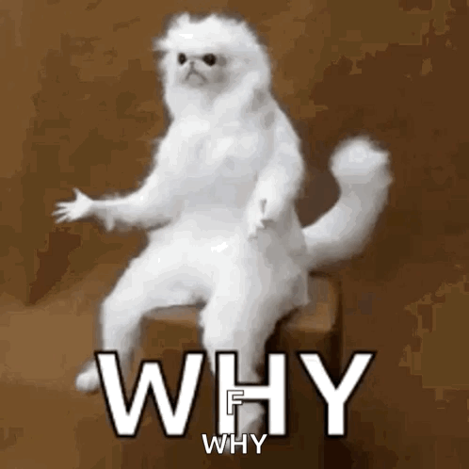
5 Reasons Why You Should Learn Python
Beginner-Friendly
Versatility Across Fields
Career Opportunities
Extensive Libraries & Community Support
Cross-Platform & Future-Proof

Slide 6
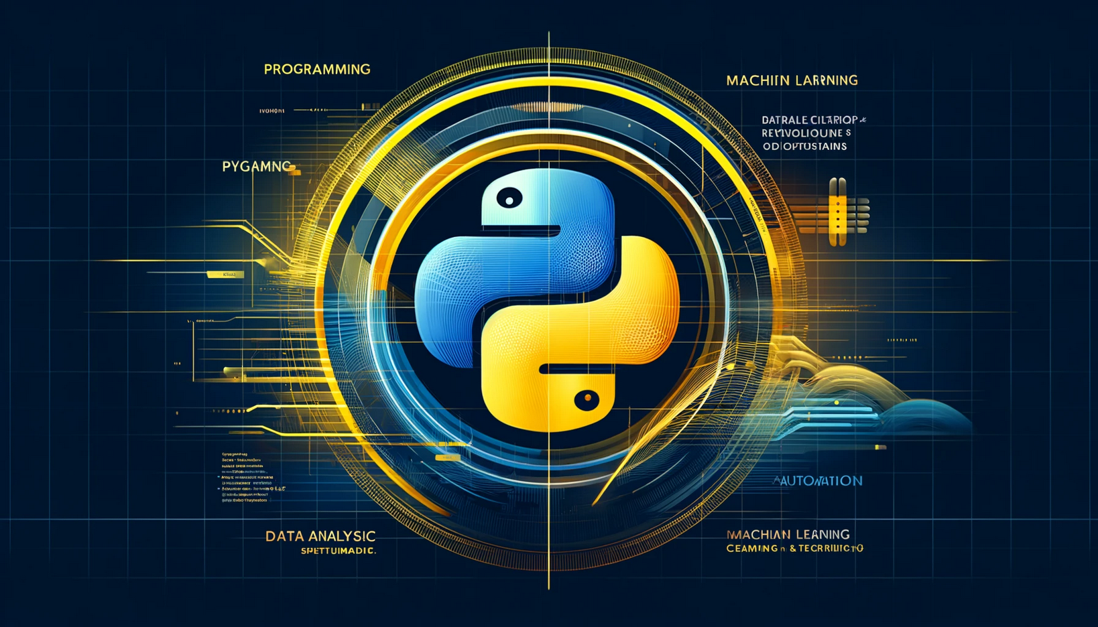
print(" Welcome to Python ! Your journey into code begins here.")

Slide 7
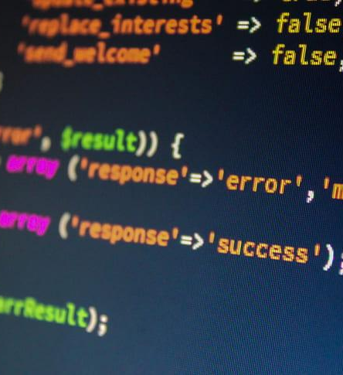
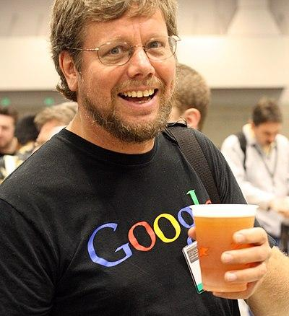
Introduction
Overview of Python and its applications
Setting up the environment (Virtualenv., Jupyter Notebooks, VSCode)
Python Syntax, Variables, and Data Types

Slide 8
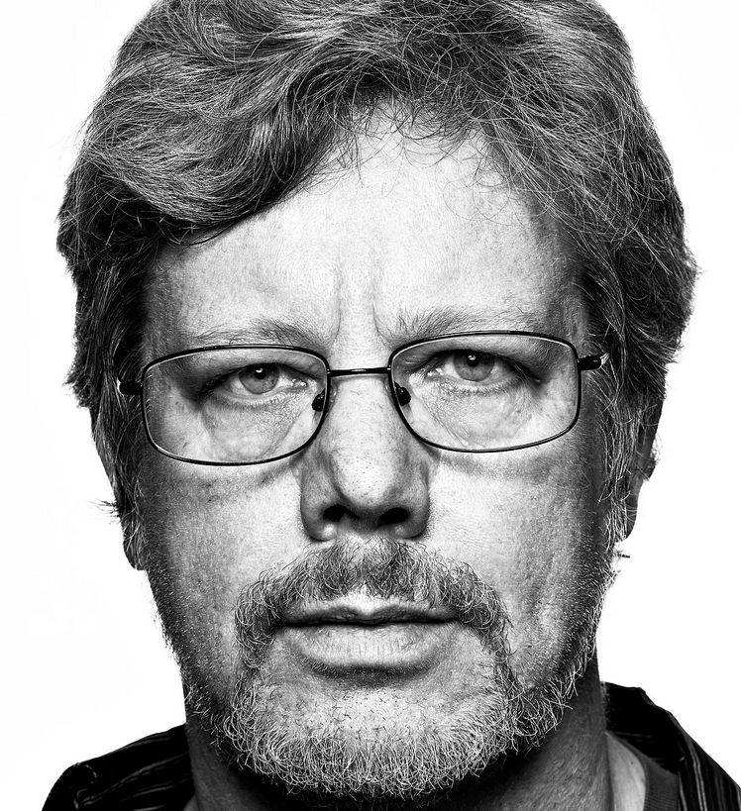
Overview of Python and its applications
Python is a high-level, interpreted programming language created by Guido van Rossum and first released in 1991.
Known for its simplicity and readability.
Open-source and cross-platform.
Van Rossum was inspired by the British comedy series Monty Python's Flying Circus and wanted to create a language that was fun and approachable. He also wanted to create a language that was easy to understand and efficient to write, with clear syntax.
Built Python from scratch in three months using a C compiler on his home Macintosh.

Slide 9





Top Companies who uses Python
Netflix uses python in personalized recommendations, Data analytics, Text automation. etx.
Google uses python in web services, in data processing and in Machine Learning and AI etc.
Spotify uses python for data processing and data analysis. etc.
Instagram ( Meta ) uses python for performance optimization and in web framework ( django). etc.
Reddit uses python to handle massive traffic, web services and at the core. etc.

Slide 10
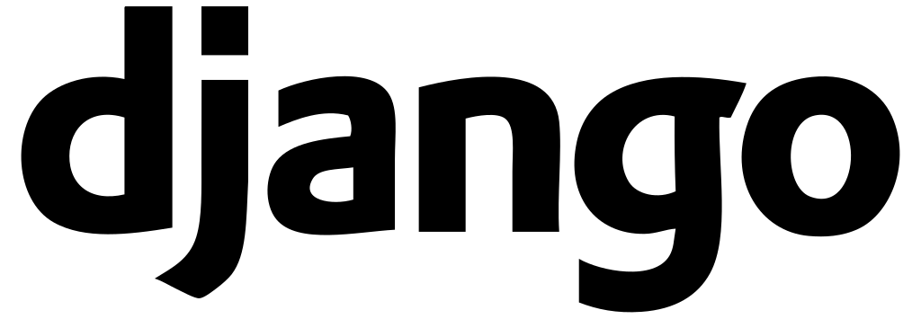




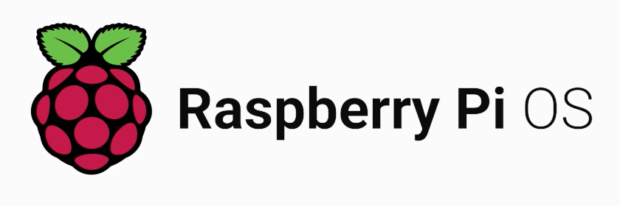
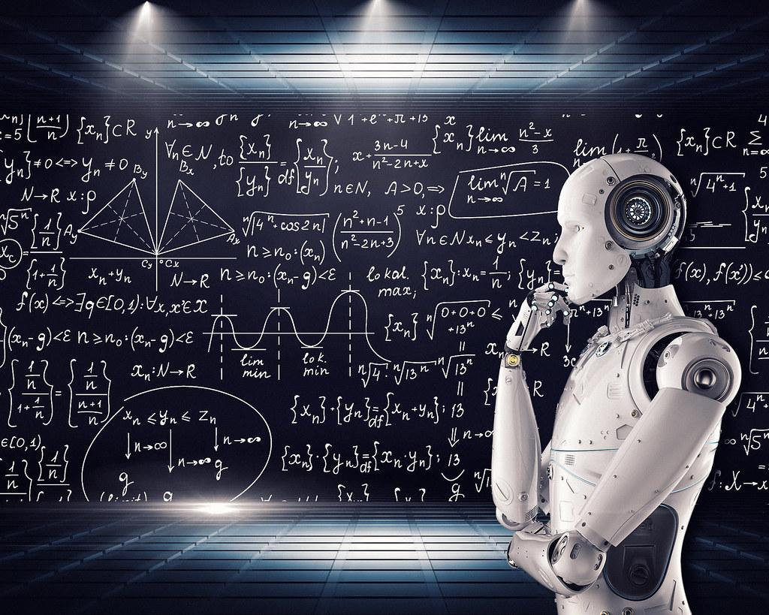
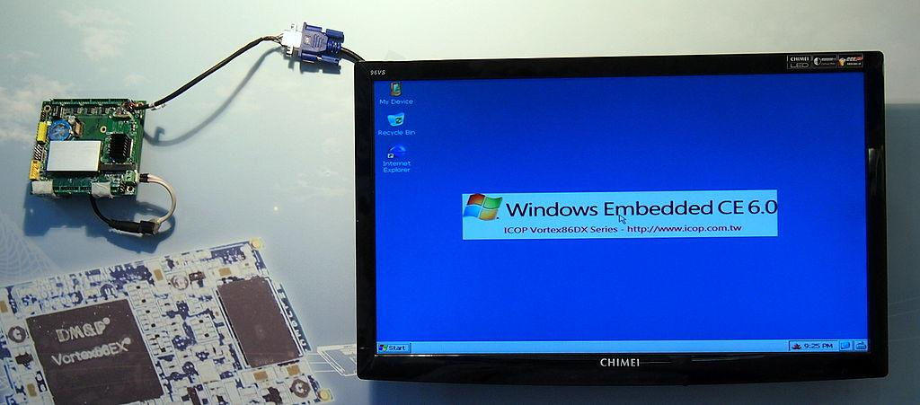
Applications of Python Programming
Web Development
Machine Learning & Artificial Intelligence
Data Science and Analytics
Automation/Scripting
IoT and Embedded Systems
Game Development, Cybersecurity etc.

Slide 11
Hello world !
Hello World Program in 3 Different Language.
C
Python
Java
#include <stdio.h>
int main() {
printf("Hello, World!\n");
return 0;
}
print("Hello, World!")
public class HelloWorld {
public static void main(String[] args) {
System.out.println("Hello, World!");
}
}

Slide 12
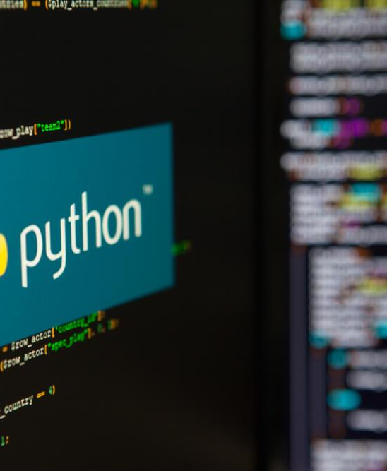
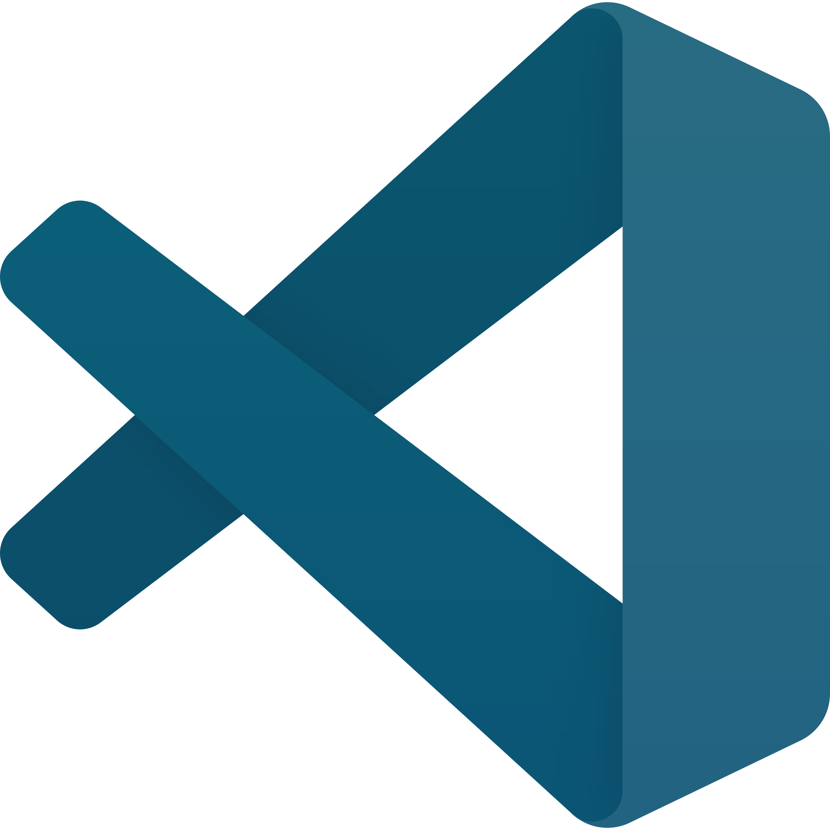
VS Code is a lightweight, customizable IDE with built-in Python support, debugging, and Git integration, making it perfect for both beginners and professionals. VS Code offers excellent support for Jupyter Notebooks through its extensions
VS Code
Virtualenv is a tool for creating isolated Python environments, allowing developers to manage dependencies for different projects without conflicts. It's lightweight, easy to use, and ensures consistent environments across development and deployment.
Virtualenv

Slide 13

SET UP
Install Python
Install Vs Code
Download Packages: Virtualenv , ipykernel.. etc.

Slide 14
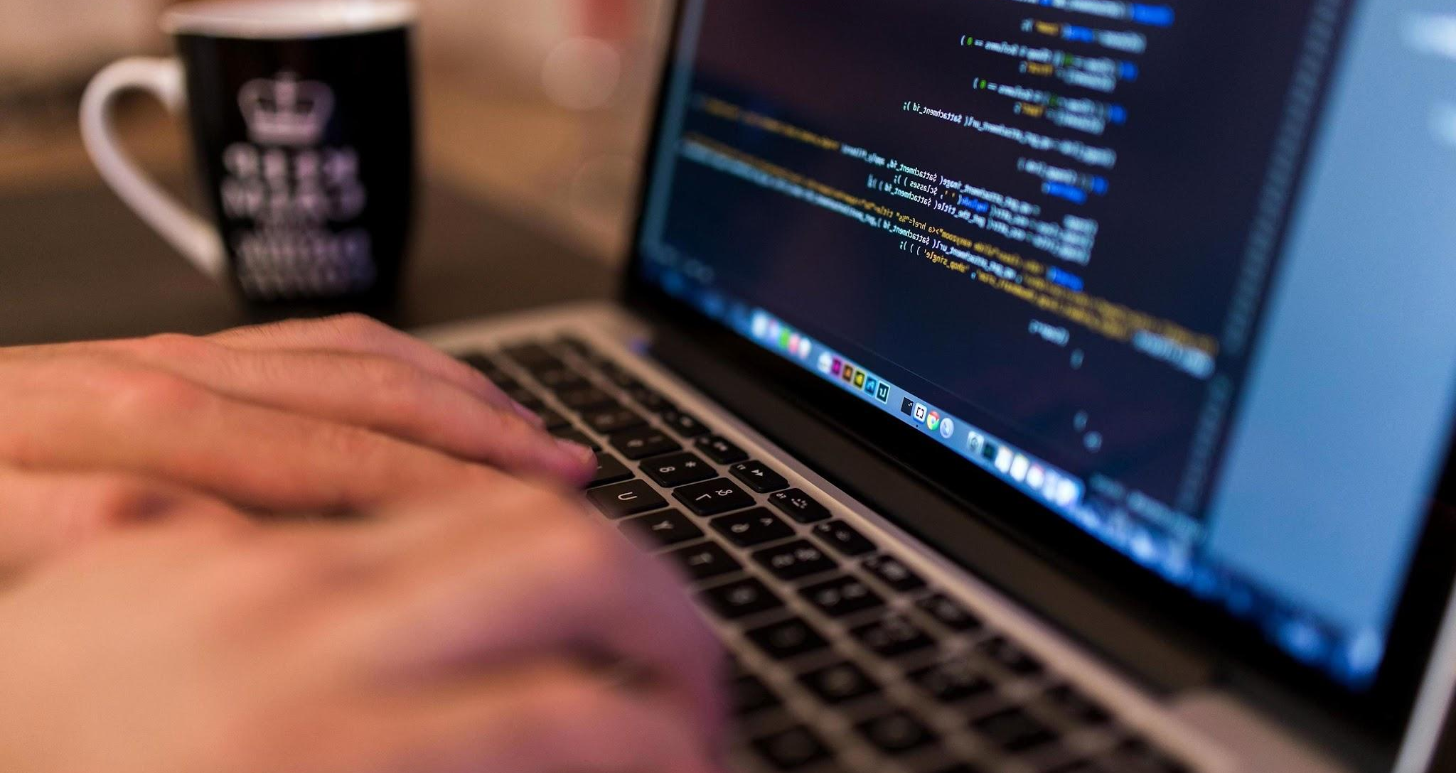
Coding…..

Slide 15
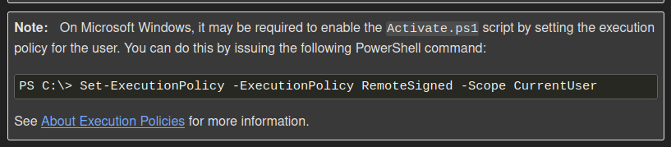
Virtualenv
Installation
python -m venv /path/to/new/virtual/environment
Activate
For Linux: source .venv/bin/activate
Creating Environment in Windows
For Windows: .venv\Scripts\activate
python -m venv /path/to/new/virtual/environment
<venv>\Scripts\Activate.ps1
Deactivate
deactivate

Slide 16
Syntax, Variable and Data Type
Syntax : Syntax refers to the guidelines that determine the structure of a language. In computer programming, syntax specifies the rules governing the arrangement of symbols, punctuation, and words within a programming language. We Know:
Programming languages function on the same principles.
If the syntax of a language is not followed, the code will not be understood by a compiler or interpreter.
Key Features of Python Syntax
Indentation: Python uses indentation to define code blocks instead of braces { }. Case Sensitivity: Python is case-sensitive.
Comments: Single line comment ( # ) , Multiline comment ( ''' ''' ). Statements: Python executes the statement in line by line manner. I.e one line at a time. Input/Output : input() is used to take user input. And print() is used to show the output.

Slide 17
Syntax, Variable and Data Type
Variable :
Variable is something that represent some information( value ) that may be string, number or any data type. They provide a way of labeling data with a descriptive name, so our programs can be understood more clearly by the reader and ourselves.
Naming a variable is important task in programming, so make sure that the name you assign your variable is accurately descriptive and understandable to another reader.
Rules for creating the variable name:
Must start with a letter or the underscore character
Cannot start with a number
Can only contain alphanumeric characters and underscores (A-z, 0-9, and _ )
Case-sensitive (mobile, Mobile and MOBILE are three different variables)
Cannot be any of the Python keywords. (Check >> help("keywords") )
Python do not have any command for creating the variable, you can just type variable name and the value along with it. Variables do not require a specific type declaration and can change their type even after being assigned a value. Type casting is also there if you want to specify the variable type.

Slide 18
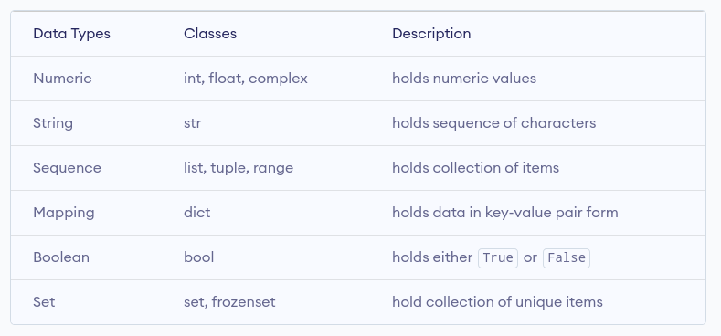
Syntax, Variable and Data Type
Data Type :
Data type refers to the classification or category of data that determines the kind of value a variable can hold and the operations that can be performed on it. It defines the nature of data, such as numeric, textual, or logical, and helps the compiler or interpreter understand how the data will be used. They define how memory is allocated for the data and also help to ensure program correctness by preventing invalid operations.
Python is a dynamically typed language, meaning variables do not need explicit type declarations.

Slide 19
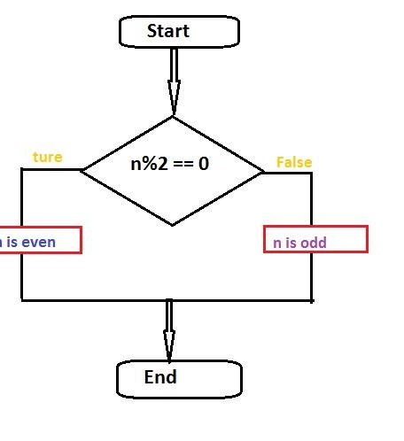
Control Structures and Functions
Conditional statements: if, else, elif
Loops: for, while, and control keywords (break, continue)
Functions: Defining, calling, return values, lambda functions
Scope and Lifetime of Variables

Slide 20
Conditional statements: if, else, elif
Conditional statements:
Conditional statements in programming are control flow structures that allow a program to make decisions and execute specific blocks of code based on whether a certain condition is True or False. These conditions are typically based on logical or comparison expressions.
Types of Conditional Statements
if: Executes a block of code if the condition is true.
else: Executes a block of code if the condition is false.
elif: Checks additional conditions if the initial if condition is false
Why Are Conditional Statements Required?
Decision-Making
Control Flow
Dynamic Behavior
Error Handling
Efficient Resource Usage

Slide 21
Loops: for, while, and control keywords (break, continue)
Loops:
Loops are a fundamental concept in programming that allow you to execute a block of code repeatedly as long as a specified condition is true. Python provides two main types of loops: for and while, along with control keywords like break, continue, and pass to manage loop behavior.
For Loop Used to iterate over a sequence (like a list, tuple, string, or range). Often used when the number of iterations is known beforehand. Combined with the enumerate() function for index-value pairs:
While Loop
The while loop runs as long as a specified condition evaluates to True. Used when the number of iterations is not known beforehand and depends on a condition.
Control College Control keywords allow you to manage the flow of loops by breaking out, skipping iterations, or using placeholders. Break: Terminates the loop prematurely, regardless of the loop condition.
Continue: Skips the current iteration and moves to the next iteration of the loop.
Pass: Does nothing. It serves as a placeholder when a statement is syntactically required but no action is desired.

Slide 22

Thank you for your time today.

